Slide 1
BASIC ELECTRONIC LAB.
LAB. OUTLINE
ELECTRONIC COMPONENTS
ELECTRONIC CIRCUIT
SOLDERING
PROJECT WORK
ASSIGNMENTS

Slide 2
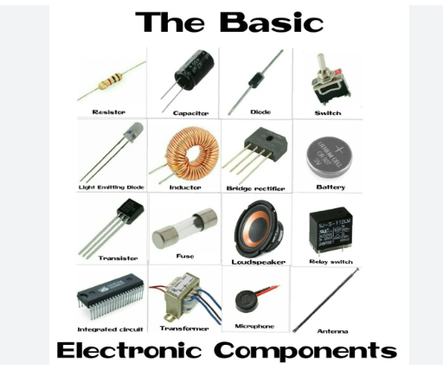

Slide 3
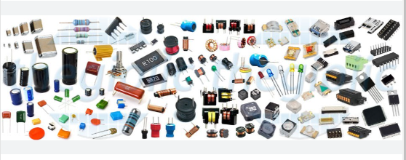
An electronic component is any basic discrete device or physical entity in an electronic system used to affect electrons or their associated fields.

Slide 4
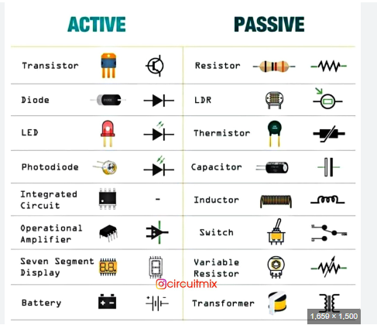

Slide 5
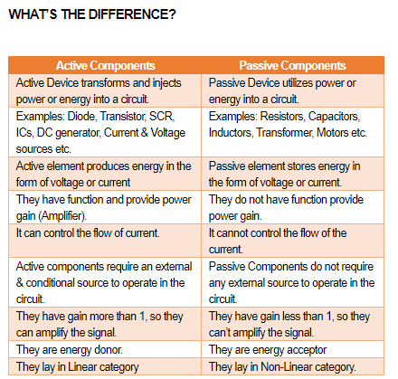

Slide 6
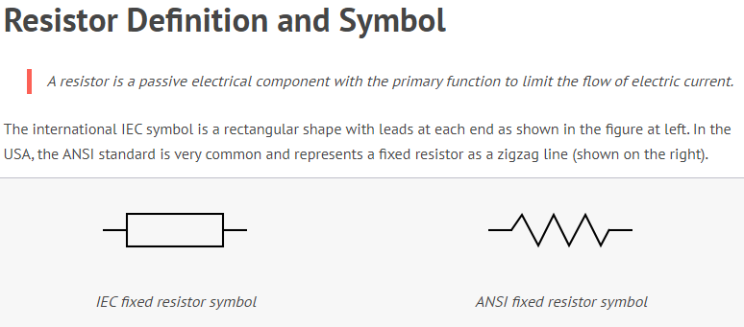

Slide 7
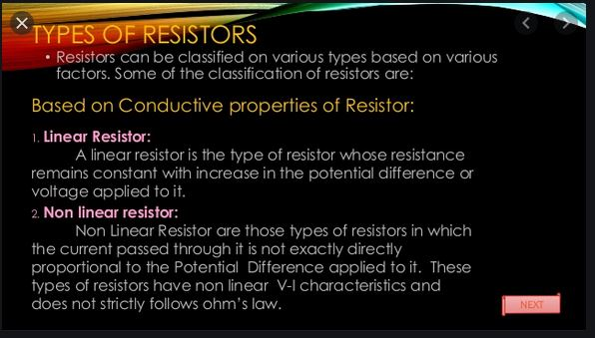

Slide 8
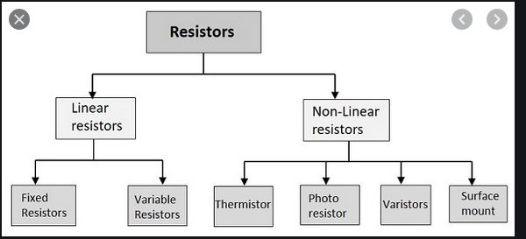

Slide 9
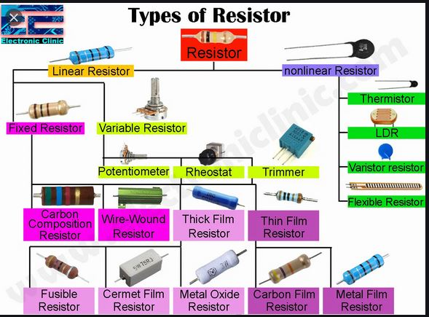

Slide 10
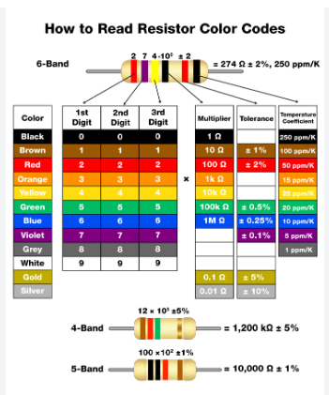

Slide 11
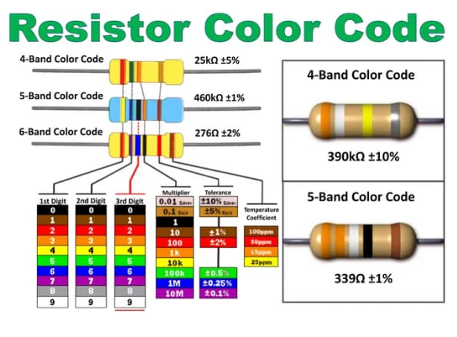

Slide 12
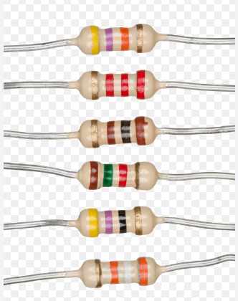
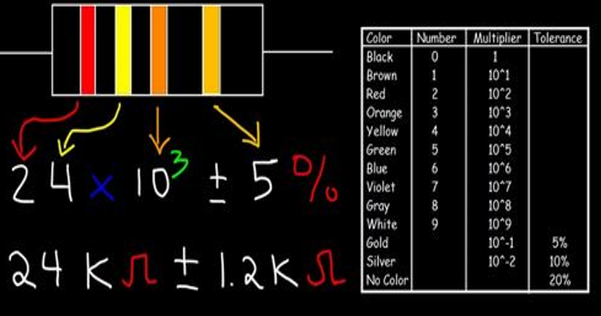
Find the value of these resistors.

Slide 13
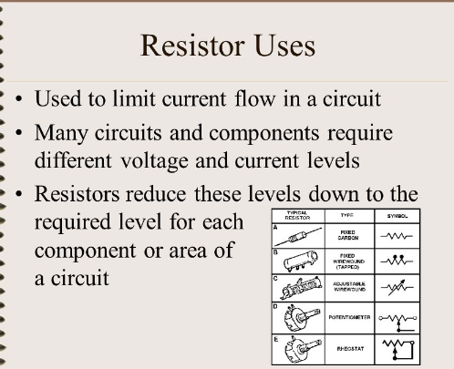

Slide 14
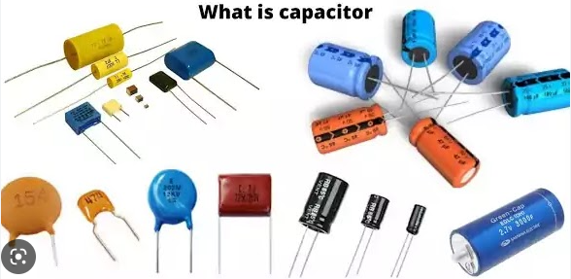
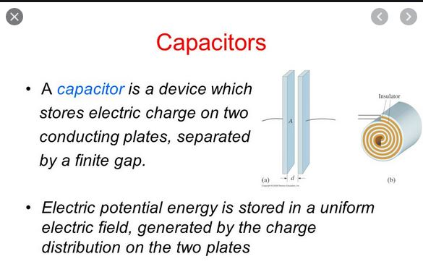

Slide 15
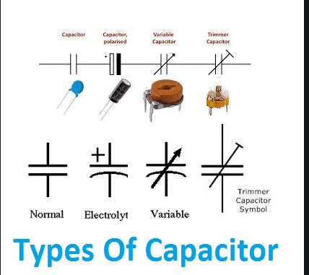

Slide 16
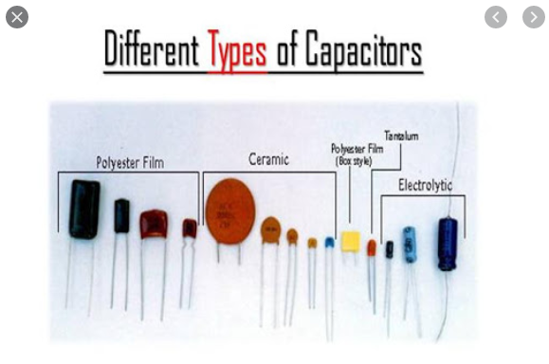

Slide 17
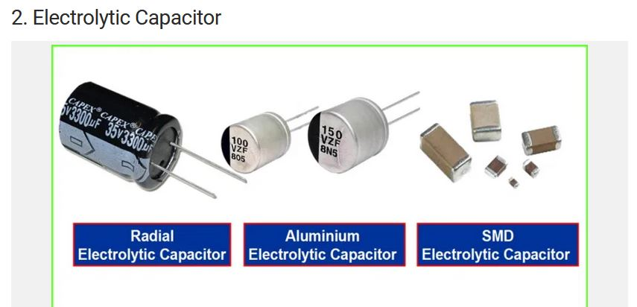
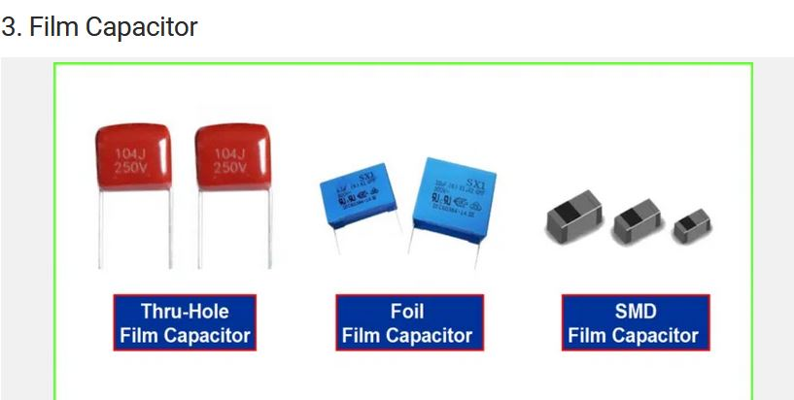
How would you determine the polarity of these type of capacitors below.

Slide 18
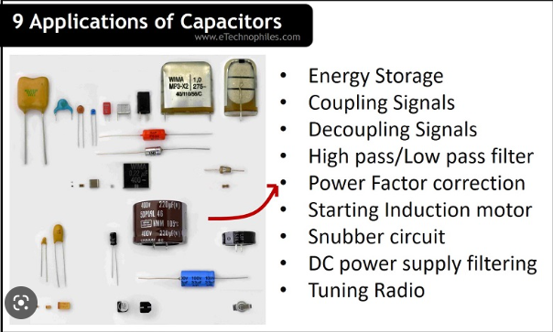

Slide 19
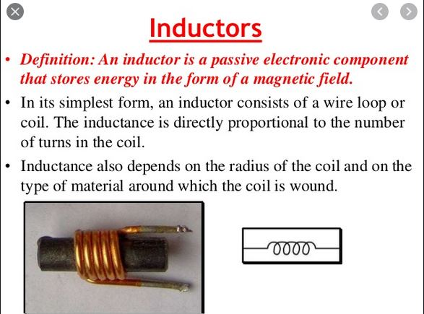

Slide 20
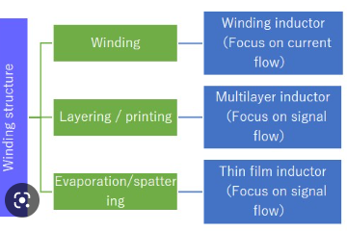

Slide 21
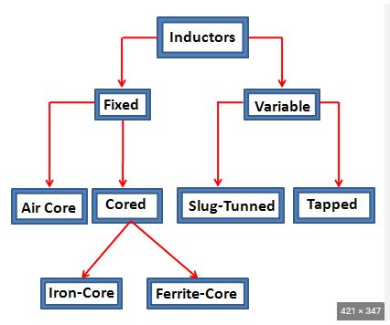
Classification of inductors

Slide 22
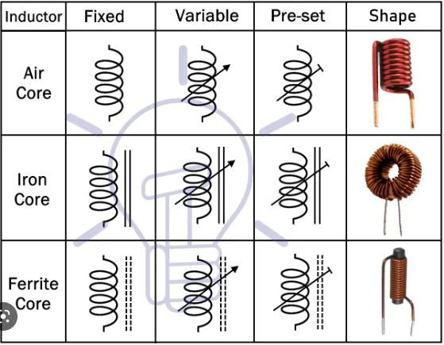

Slide 23
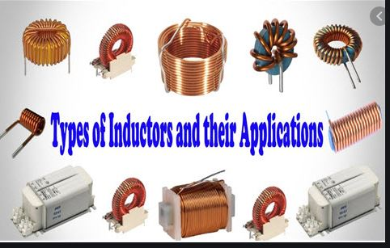
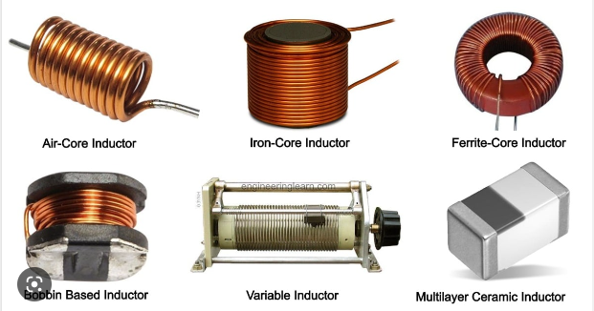
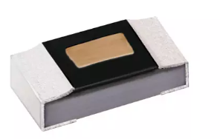

Slide 24
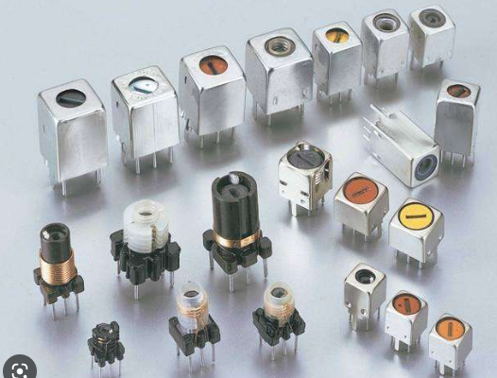
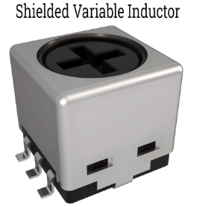
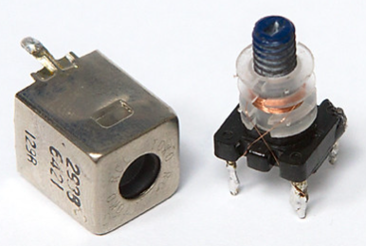

Slide 25
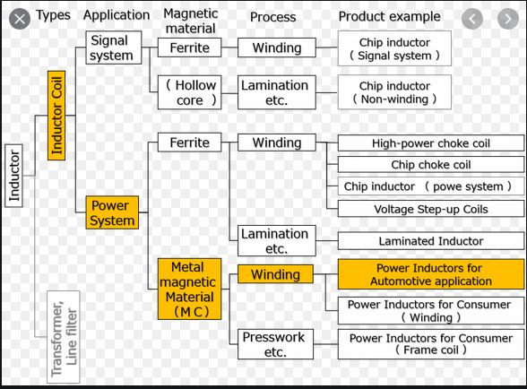

Slide 26
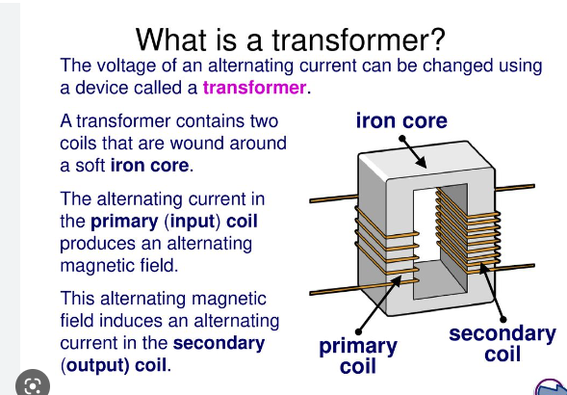

Slide 27
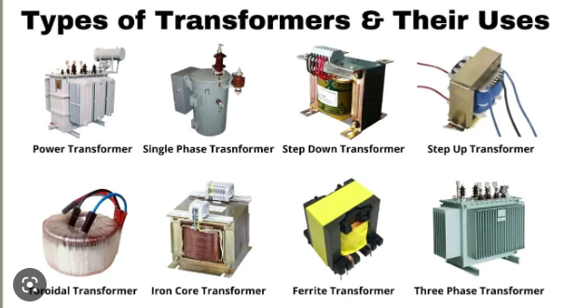

Slide 28
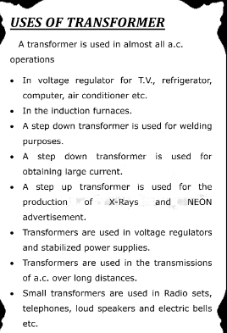

Slide 29
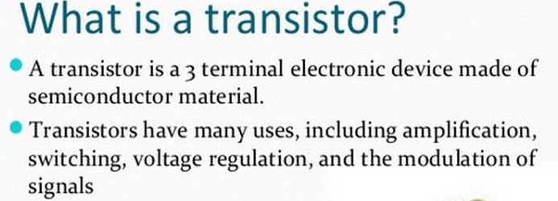
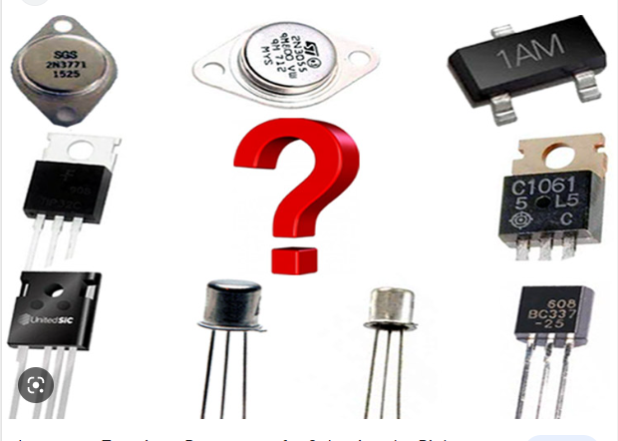

Slide 30
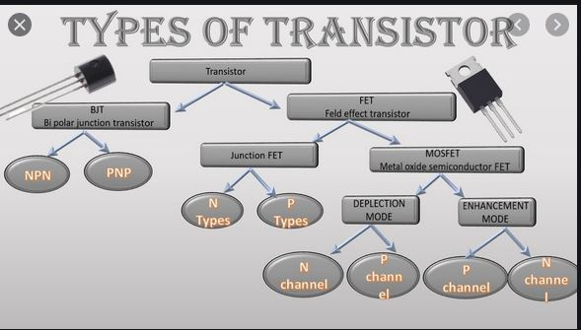

Slide 31
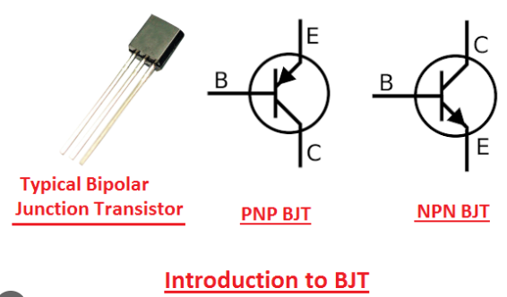
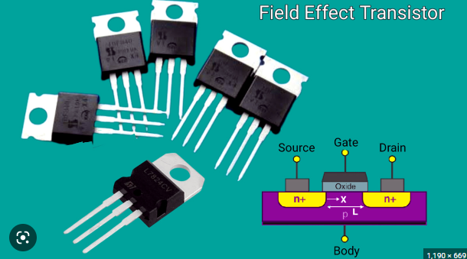
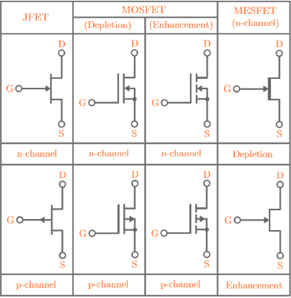

Slide 32
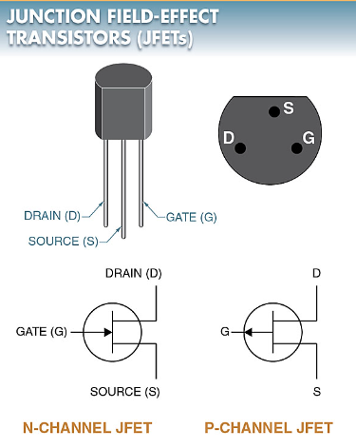
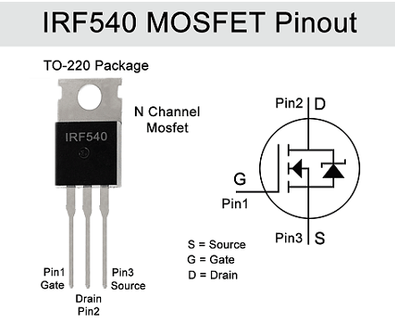

Slide 33
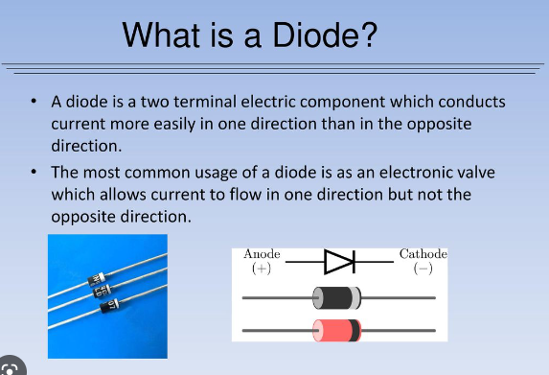

Slide 34
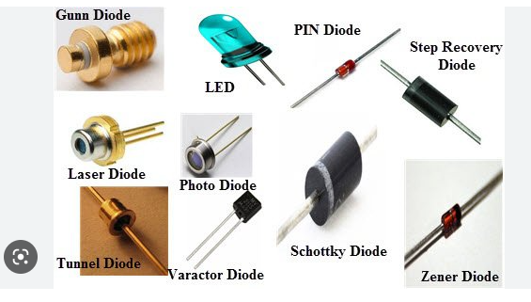

Slide 35
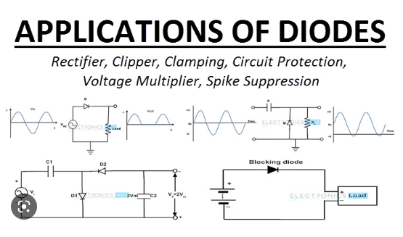

Slide 36
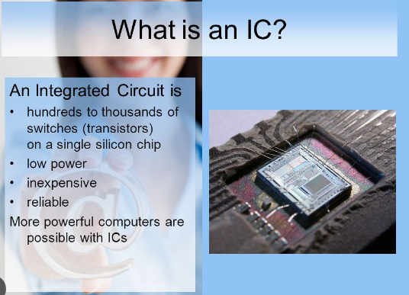
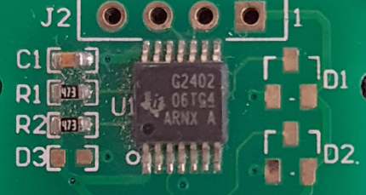
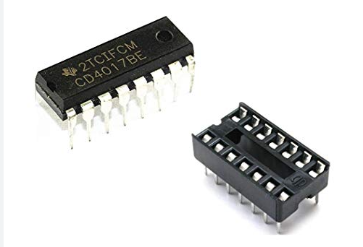
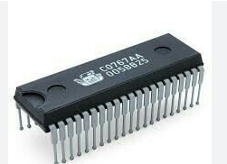
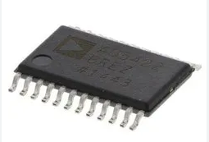

Slide 37


Slide 38


Slide 39


Slide 40


Slide 41


Slide 42



Slide 43

An electronic circuit is a structure that directs and controls electric current to perform various functions including signal amplification, computation, and data transfer. It comprises several different components such as resistors , transistors, capacitors, inductors, diodes, and ICs. Eg Touch sensor cct. diagram.

Slide 44



Slide 45

Identifier all the symbols in the cct. below.

Slide 46

What is the function of this circuit below? List all the components for the circuit below.

Slide 47



Slide 48


Slide 49


Slide 50


Slide 51


Slide 52

With these components below design a simple strobe circuit.
Transistor- (BC 547)
Capacitor
LED
Resistor (One K)

Slide 53
With these components below design an LED chaser circuit.
Transistor- C9014
LED
Capacitor
Resistor- 10K,560 ohm

Slide 54

With these components below design a Non-inverting amplifier.
IC- UA 741
Resistor – 10K, 47K

Slide 55

With these components below design an inverting amplifier.
IC- UA 741
Resistor – 10K, 47K

Slide 56
THANK YOU

